Slide 1
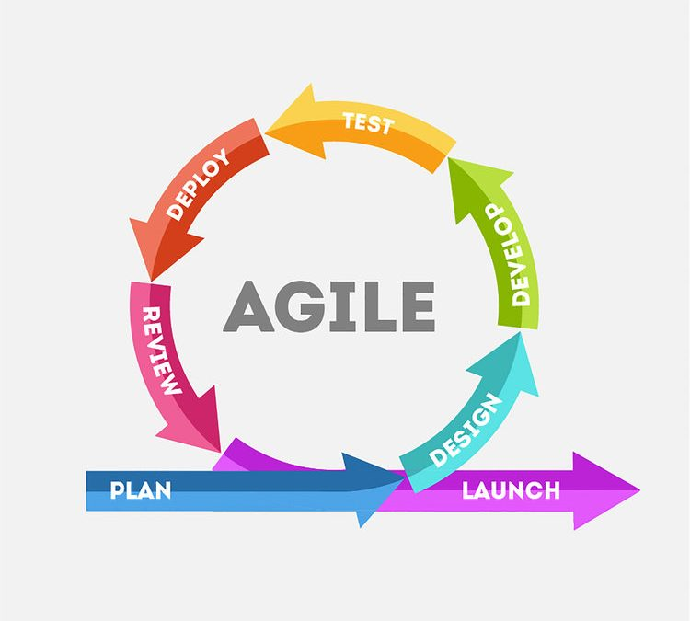
AGILE DEVELOPMENT LIFECYCLE
Presented By
335-Swaroop Kumar Reddy

Slide 2
STRENGTHS OF AGILE METHODOLOGY:
» The Agile Methodology allows you to make changes even after
the initial planning. Rewrites to the program can be made whenever
when the client decides to make changes.
» It also allows you to add features that keep you updated with the advances
In your Industry.
» It also allows clients to give their feedback and makes sure that they get
the product they desire.

Slide 3
»Well-known processes with over 400,000 practitioners trained in their use
» Significant number of successes in the physical deliverable arena
» Support of very large project team with distributed locations and languages
» Knowledge of what constitutes a successful completion (if planning done correctly)
» Arms-length relationship between project owner and project team
» Up front estimation of project’s scope, schedule, and budget
» Identified responsibility for the project’s success or failure

Slide 4
» High flexibility of the project. Short cycles and constant iterations
allow you to adapt your project frequently and tailor it to the customer’s
needs at any moment. You don’t have to waste your time and resources on
delivering a full project which will be rejected by the customer. This makes
the development process extremely flexible.
» High customer satisfaction over the development process. Since Agile
projects are closely coordinated with the customer, he/she has a strong impact
on the development project. Software pieces are delivered constantly, in short
cycles and customer’s feedback is always taken into consideration.

Slide 5
» Constant interaction among the stakeholders. With your teams constantly
interacting with each other and with the customer, you avoid producing tons
of technical documentation, processes, and tools. Each member feels like an
important part of the team participating in the decision-making process.
This stimulates creativity and initiative and leads to better results.
» Continuous quality assurance, attention to details. Quality of the product
should be ensured by the testing team from the early stages of
Agile development. Since the development is conducted in short cycles,
testing is run non-stop, allowing you to produce a good final product.
THANKING YOU.

